Slide 1
PBIS and Equity in Education
To ensure an equitable education for all students, there is a need for school teams to review their data informing whether implementation of PBIS has improved the outcomes for each racial/ethnic minority group.
(McIntosh, Eliason, Horner, & May, 2013)
Facilitators:
Barbara Kelley and Cristy Clouse
Notes:
When students in a specific subgroup receive higher rates of discipline referrals than their counterparts, the relationship between students and school is weakened (Skiba eta al., 2011; Boneshefski & Runge, 2013).
Analyzing disaggregated ODR data allows schools to evaluate whether their disciplinary practices are disproportionately affecting various student groups (e.g., ethnic minority students) (Boneshefski & Runge, 2013)
To ensure an equitable education for all students, there exists a need to review outcome data for various racial/ethnic groups.
Overrepresentation of minority students in a school’s discipline data may indicate that a school’s current systems and practices are not meeting the needs of minority students.
IDEA: Evaluating discipline data among ethnic groups is a way for schools to work toward improved student outcomes for ALL students.

Slide 2
Culturally Responsive Tier I Core Features
Consequences for Problem Behavior
System to Acknowledge
Behavior
Classroom Systems
School-wide Expectations
Data and Decision System
Leadership Team
Family Engagement
Bully Prevention

Slide 3
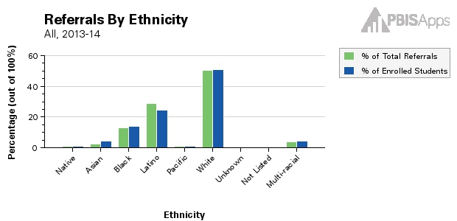
SWIS Three Point Perspective
School Ethnicity Report
Does an ethnic group receive referrals proportionate to their size in the school population?
Percent of total referrals by ethnic group compared to percent of enrollment for that ethnic group.
Latino students make up 24.60% of the school’s total population and 28.68% of the school’s total referrals come from Latino students.
Notes:
The percentage of enrolled students compared to the percentage of office discipline referrals received by each ethnic/racial group: Referrals by Ethnicity
What does it compare?
Percent of total referrals an ethnic group has compared to the percent of total school population that ethnic group composes.
Value?
Helps evaluate whether a certain ethnic group has a disproportionate percentage of referrals compared to what percentage of the total school population the same ethnicity group composes.
Big Idea: Is the proportion of referrals coming from an ethnic group equal to the size of the group?

Slide 4
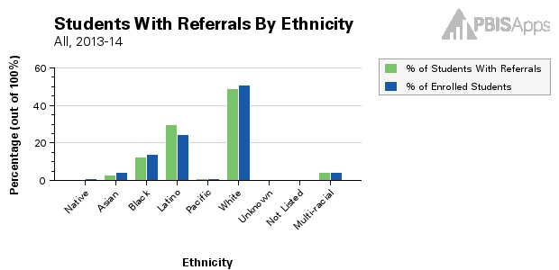
SWIS Three Point Perspective
School Ethnicity Report
Of the students who have referrals in the school, does an ethnic group receive referrals proportionate to their size in the school population?
Percent of students with referrals by ethnicity compared to percent of enrollment for that ethnic group.
Latino students make up 24.60% of the school’s total population and 29.97% of students in the school with referrals are Latino.
Notes:
The percentage of all enrolled students compared to the percentage of students from each group with referrals: Students w/Referrals by Ethnicity
What does it compare?
Percent of all students who have referrals who belong to a certain ethnic group compared to the percent of total school population that same ethnic group composes.
Value?
Helps evaluate whether a certain ethnic group has a disproportionate percentage of students being referred compared to the ethnicity group’s percentage of the total

Slide 5
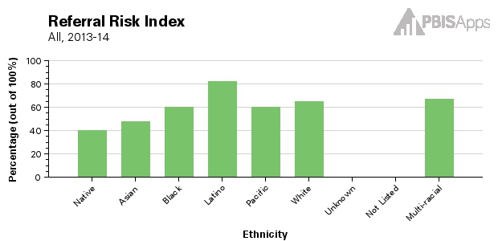
SWIS Three Point Perspective
School Ethnicity Report
Are ethnic groups being referred at the same rate?
Number of students in a group with an ODR divided by total number of students enrolled in the group.
82.11% of the school’s Latino students have had a referral and 64.71% of the school’s White students have had a referral.
Notes:
The percentage of students within each racial/ethnic group with referrals, commonly referred to as the Referral Risk Index
What does it compare?
Percent of students in an ethnic group who have referrals compared to the percent of students in other ethnic groups who have referrals.
Value?
Helps compare rates of referrals across groups
Helps identify ethnic groups that may be disproportionate

Slide 6
HOUSTON…

Slide 7
TO OFTEN…
Kent McIntosh, PhD
University of Oregon
National PBIS Center

Slide 8
GET GOING…
Talk at your table:
“What approaches have you tried to build a commitment to equity in your schools?”
“How have they worked?”

Slide 9
Intervention Approach McIntosh, Girvan, Horner, Smolkowski, & Sugai, 2014
Use engaging academic instruction to reduce the support gap (achievement gap)
Implement a behavior framework that is preventive, multi-tiered, and culturally responsive
Collect, use, and report disaggregated discipline data
Develop policies with accountability for disciplinary equity
Teach neutralizing routines for vulnerable decision points
http://www.pbis.org/school/equity-pbis

Slide 10
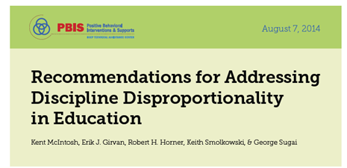
Effective Instruction
Inside Outside
Circle
Teach neutralizing routines for VDP’s
Processing Activity
http://www.pbis.org/school/equity-pbis
Develop policies with accountability for Disciplinary Equity
School-wide
PBIS
Collect, Use, Report Disaggregated Discipline data
Notes:
Before begin read, go to PBIS.org and show where all of the articles are located. This first article is just to begin the conversation

Slide 11
Explicit
Conscious belief that some groups aspire to desirable traits more than others
Implicit
Unconscious associations regarding some groups

Slide 12
Multidimensional View

Slide 13
Reduce the Effects of Implicit Bias
Reduce ambiguity in ODR definitions and behavior referral process
Clear definitions of problem behavior
Clear guidelines for staff vs. teacher managed behaviors
Identify specific vulnerable decision points
National Data
Local (district or school)
Teach a neutralizing routine
Self-Assess presence of VDP
Use alternative response

Slide 14
What is a Vulnerable Decision Point (VDP)?
A specific decision that is more vulnerable to effects of implicit bias.
Two parts:
Elements of the situation
The person’s decision state (internal state)

Slide 15
Options for Identifying VDP
Drill down ODR/Suspension/Expulsion Decisions
Identify VDP’s through National data
Use School or District Data

Slide 16
VDP DRILL DOWN FROM DISCIPLINE DATA
School determine Disproportionality as a Red Flag
Drill down race/ethnicity (Who) data by
What
Where
When
Who (gender specific)
Why (perceived motivation)
May identify multiple VDP’s

Slide 17
VDP’s from National Data
AMBIGUITY
Subjective Problem Behavior
Defiance, Disrespect, Disruption
Major (office managed) vs. Minor (teacher managed)
Afternoons
Classrooms
DEMANDS? RELEVANCE? REALTIONSHIP?
FATIGUE

Slide 18
TWO STEP NEUTRALIZING ROUTINES FOR STAFF
1. When you see the problem behavior stop and ask yourself:
Is this a VDP?
Situation
Decision State
2. If so, use an agree-upon alternative response

Slide 19
Neutralizing Routines for Reducing Effects of Implicit Bias
Self Assessment
Is this a Vulnerable Decision Point?
Setting Event
Lack of positive interactions with student
Fatigue
Antecedent
Loud complaints about work
Subjective behavior
Behavior
Send student to the office
ODR
Consequence
Student leaves class
Escape assignment and social situation
Alternative Response
“See me after class and we can talk about it”

Slide 20
What makes for a good neutralizing routine?
If-then statements (now-that)
Brief
Clear Steps
Doable
Interrupts the chain of events

Slide 21
Neutralizing Routines as Pre-Corrections
“Am I about to enter a VDP?”
“What are my values?”
“When I see problem behavior, I’ll use the alternative response.”

Slide 22
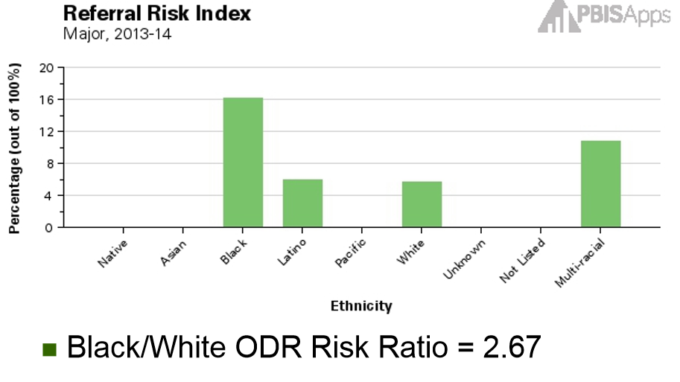
Disproportionality Drill Down “Red Flag”

Slide 23
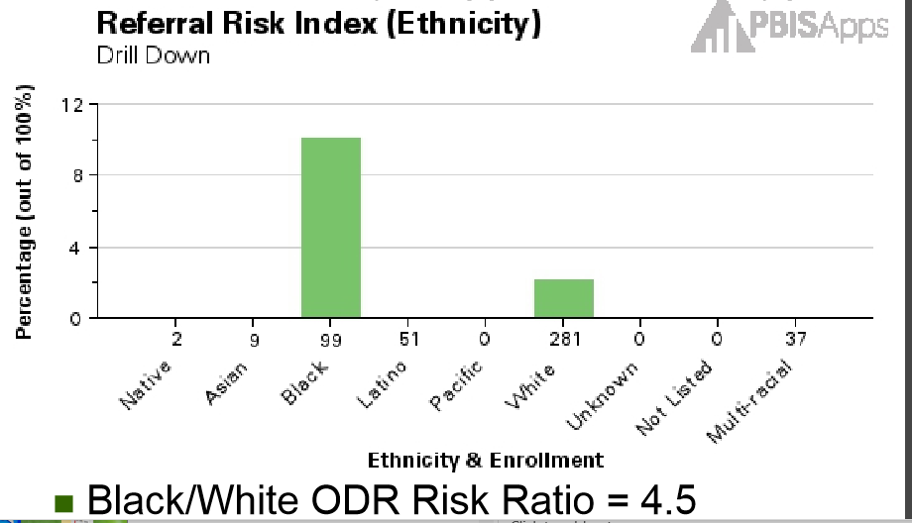
Drill Down: Physical Aggression (what) on Playground (where)
(Who)

Slide 24
Intervention
ODRs and observations indicated differences in perceived basketball rules
Team clarified rules for staff and students
AKA “code-switching”
Additional teaching, practice and acknowledgment
Monitor with ODRs and Black-White Risk Ratios

Slide 25
Intervention Outcomes
Black-White Risk Ratios
Overall
2013-14: 2.67
2014-15(Sept to Dec.): 2.0
Physical Aggression on the Playground
2013-14: 4.5
2014-15(Sept to Dec): can’t calculate (1 ODR)

Slide 26
What about the Administrator and Disproportionality?
What is the strongest predictor of disproportionality in school discipline?
The school principal’s endorsement of exclusionary discipline and zero tolerance policies.
(Skiba, Trachok, Chung, & Baker, 2012)

Slide 27
VDP’s for Administrators
When you have to handle problem behaviors stop and tell yourself…
Don’t just do something, stand there
Be sure you are ready to act in line with your values
Get information from student and staff
Assess student-teacher relationship
Whenever possible, use an agreed upon instructional response
Teaches missing skill
Connects student to school and staff

Slide 28
“The Restorative Chat ”
Tell me what happened.
What you were thinking at the time?
Who did this affect?
What do you need to do about it?
How can we make sure this doesn’t happen again?
What can I do to help you?

Slide 29
Culturally Conscious
Self-Assessment
www.edequity.com
The purpose of the Culturally Conscious Positive Behavior Intervention Support (CCPBIS)
survey is to identify key understanding of how culture impacts the educators’ knowledge,
skills and action in implementing social/emotional and academic preventive support
structures for diverse students.
Consciousness
Culture
Caring
Congruency

Slide 30
PBIS and Equity in Education
This 90 minute presentation will engage you in an evidence-based process to address disproportionality in behavior data and promote equity in your school. Learn about culturally responsive Tier I practices, Vulnerable Decision Points, Neutralizing Routines and Equitable Interventions. Participants will complete a Culturally Conscious Self-Assessment.

